Slide 1
1.4. Hardware Random Number Generator
Preston Maness

Slide 2

Motivation

Slide 3
Why?
Familiarize myself with an important aspect of modern cryptographic systems.
Gain experience with signal shaping.
Explore the interface between hardware and software and how it can be both exploited and hardened.

Slide 4
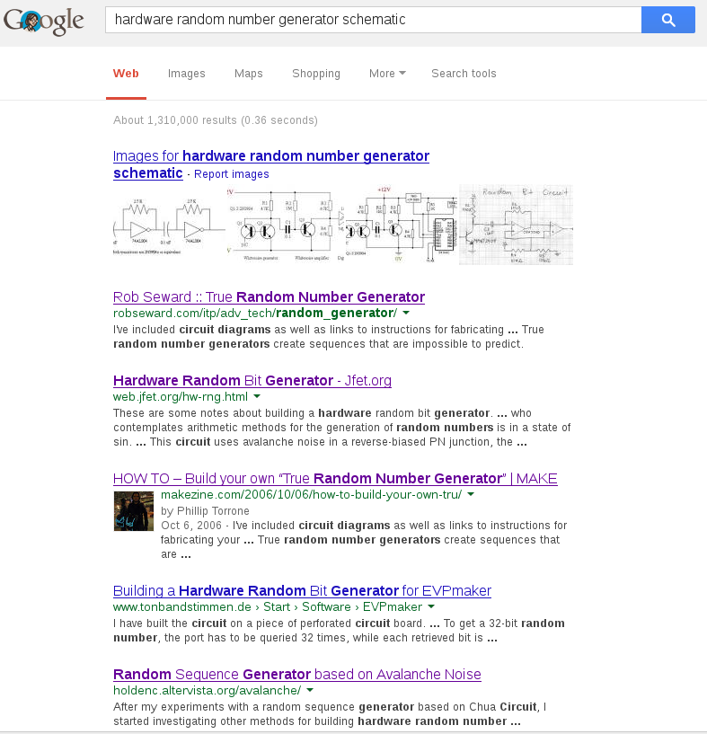
On the Shoulders of Giants

Slide 5
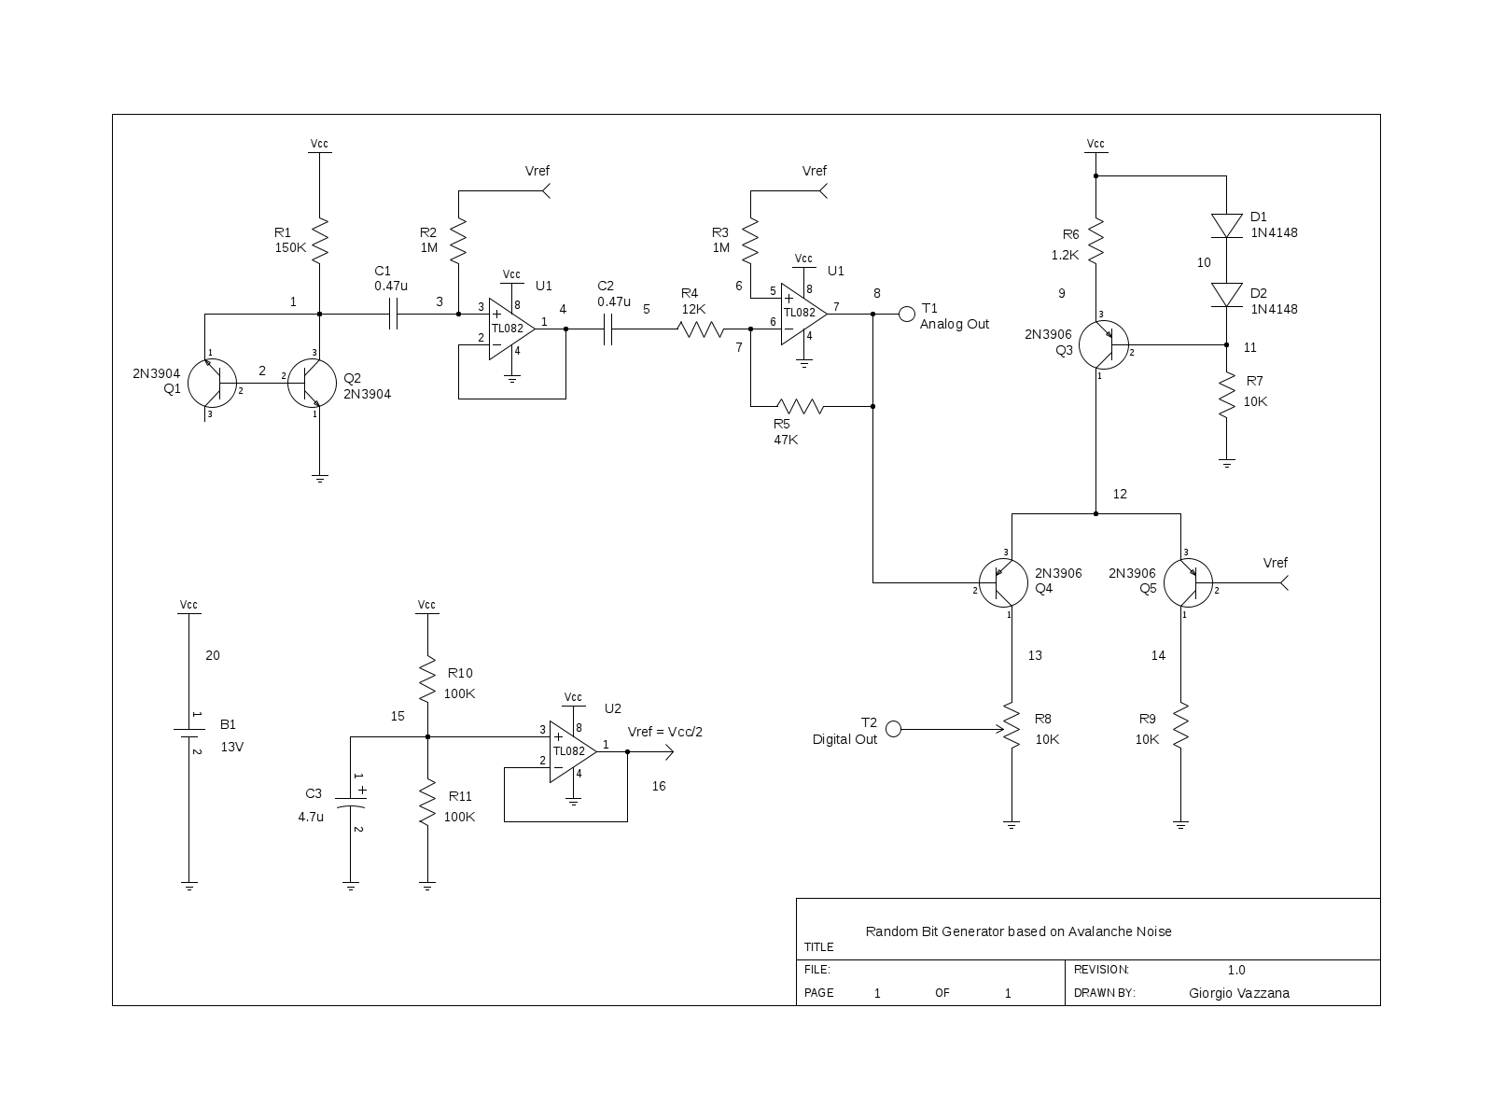
Giorgio Vazzana

Slide 6

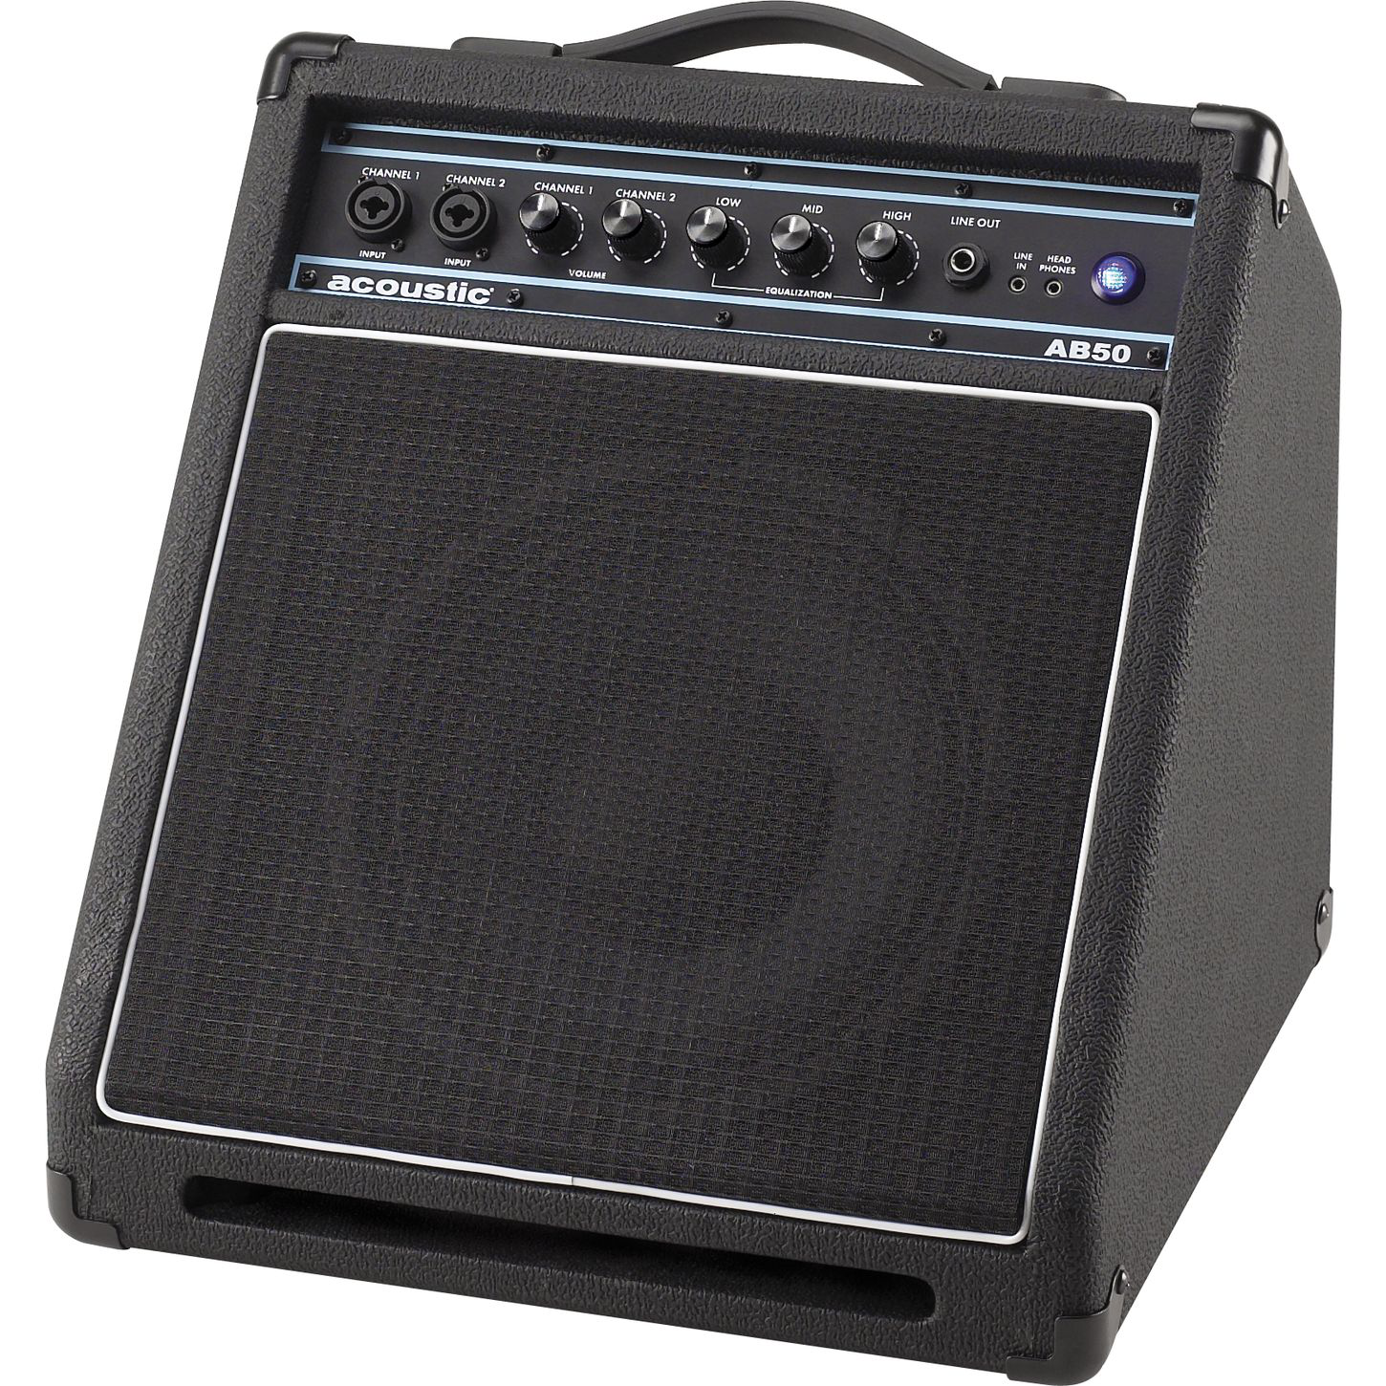
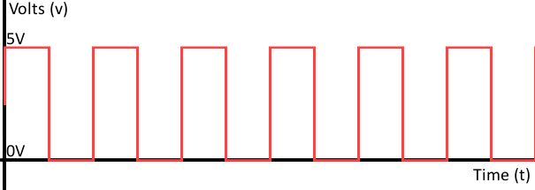
General Principle
Amplify
Digitize

Slide 7
Hardware Block Diagram
Noise Source
Amplification
Buffering
Comparison
Arduino Serial
GNU/Linux Host

Slide 8
Software Stack
Serial Monitor
(Arduino)
Perl Script
(Monitor->Binary)
Dieharder RNG
Stress Tester

Slide 9
Deliverables
Functioning prototype that outputs bits to the host.
Host is able to read this bitstream.
Host tests the randomness of bitstream.
Inclusion of verified bitstream into entropy pool.
Hardware-side verification.
Automated testing.

Slide 10
Timeline
Timeframe | Goals
Continuous | Research, Verify, Research, and Research some more.
By end of September | Verification pipeline determined (dieharder). Hardware to host communication.
By end of October | Verification pipeline functional and providing results of its tests.
By end of semester | Verified bitstream. Automated testing.

Slide 11
Expense Report
Item | Quantity | Cost
Op-Amp (TL082) | 50 | $9.99
BJT (2N3904) | 50 | $4.98
Comparator (LM339N) | 10 | $3.50
Arduino Uno | 1 | $25 (Already Owned)
Resistors | 100 | ~$5 (Already Owned)
Capacitors | 20 | ~$5 (Already Owned)
Wiring | Varied | $2.98
 | TOTAL: OUT OF POCKET: | $56.45 $21.45

Slide 12
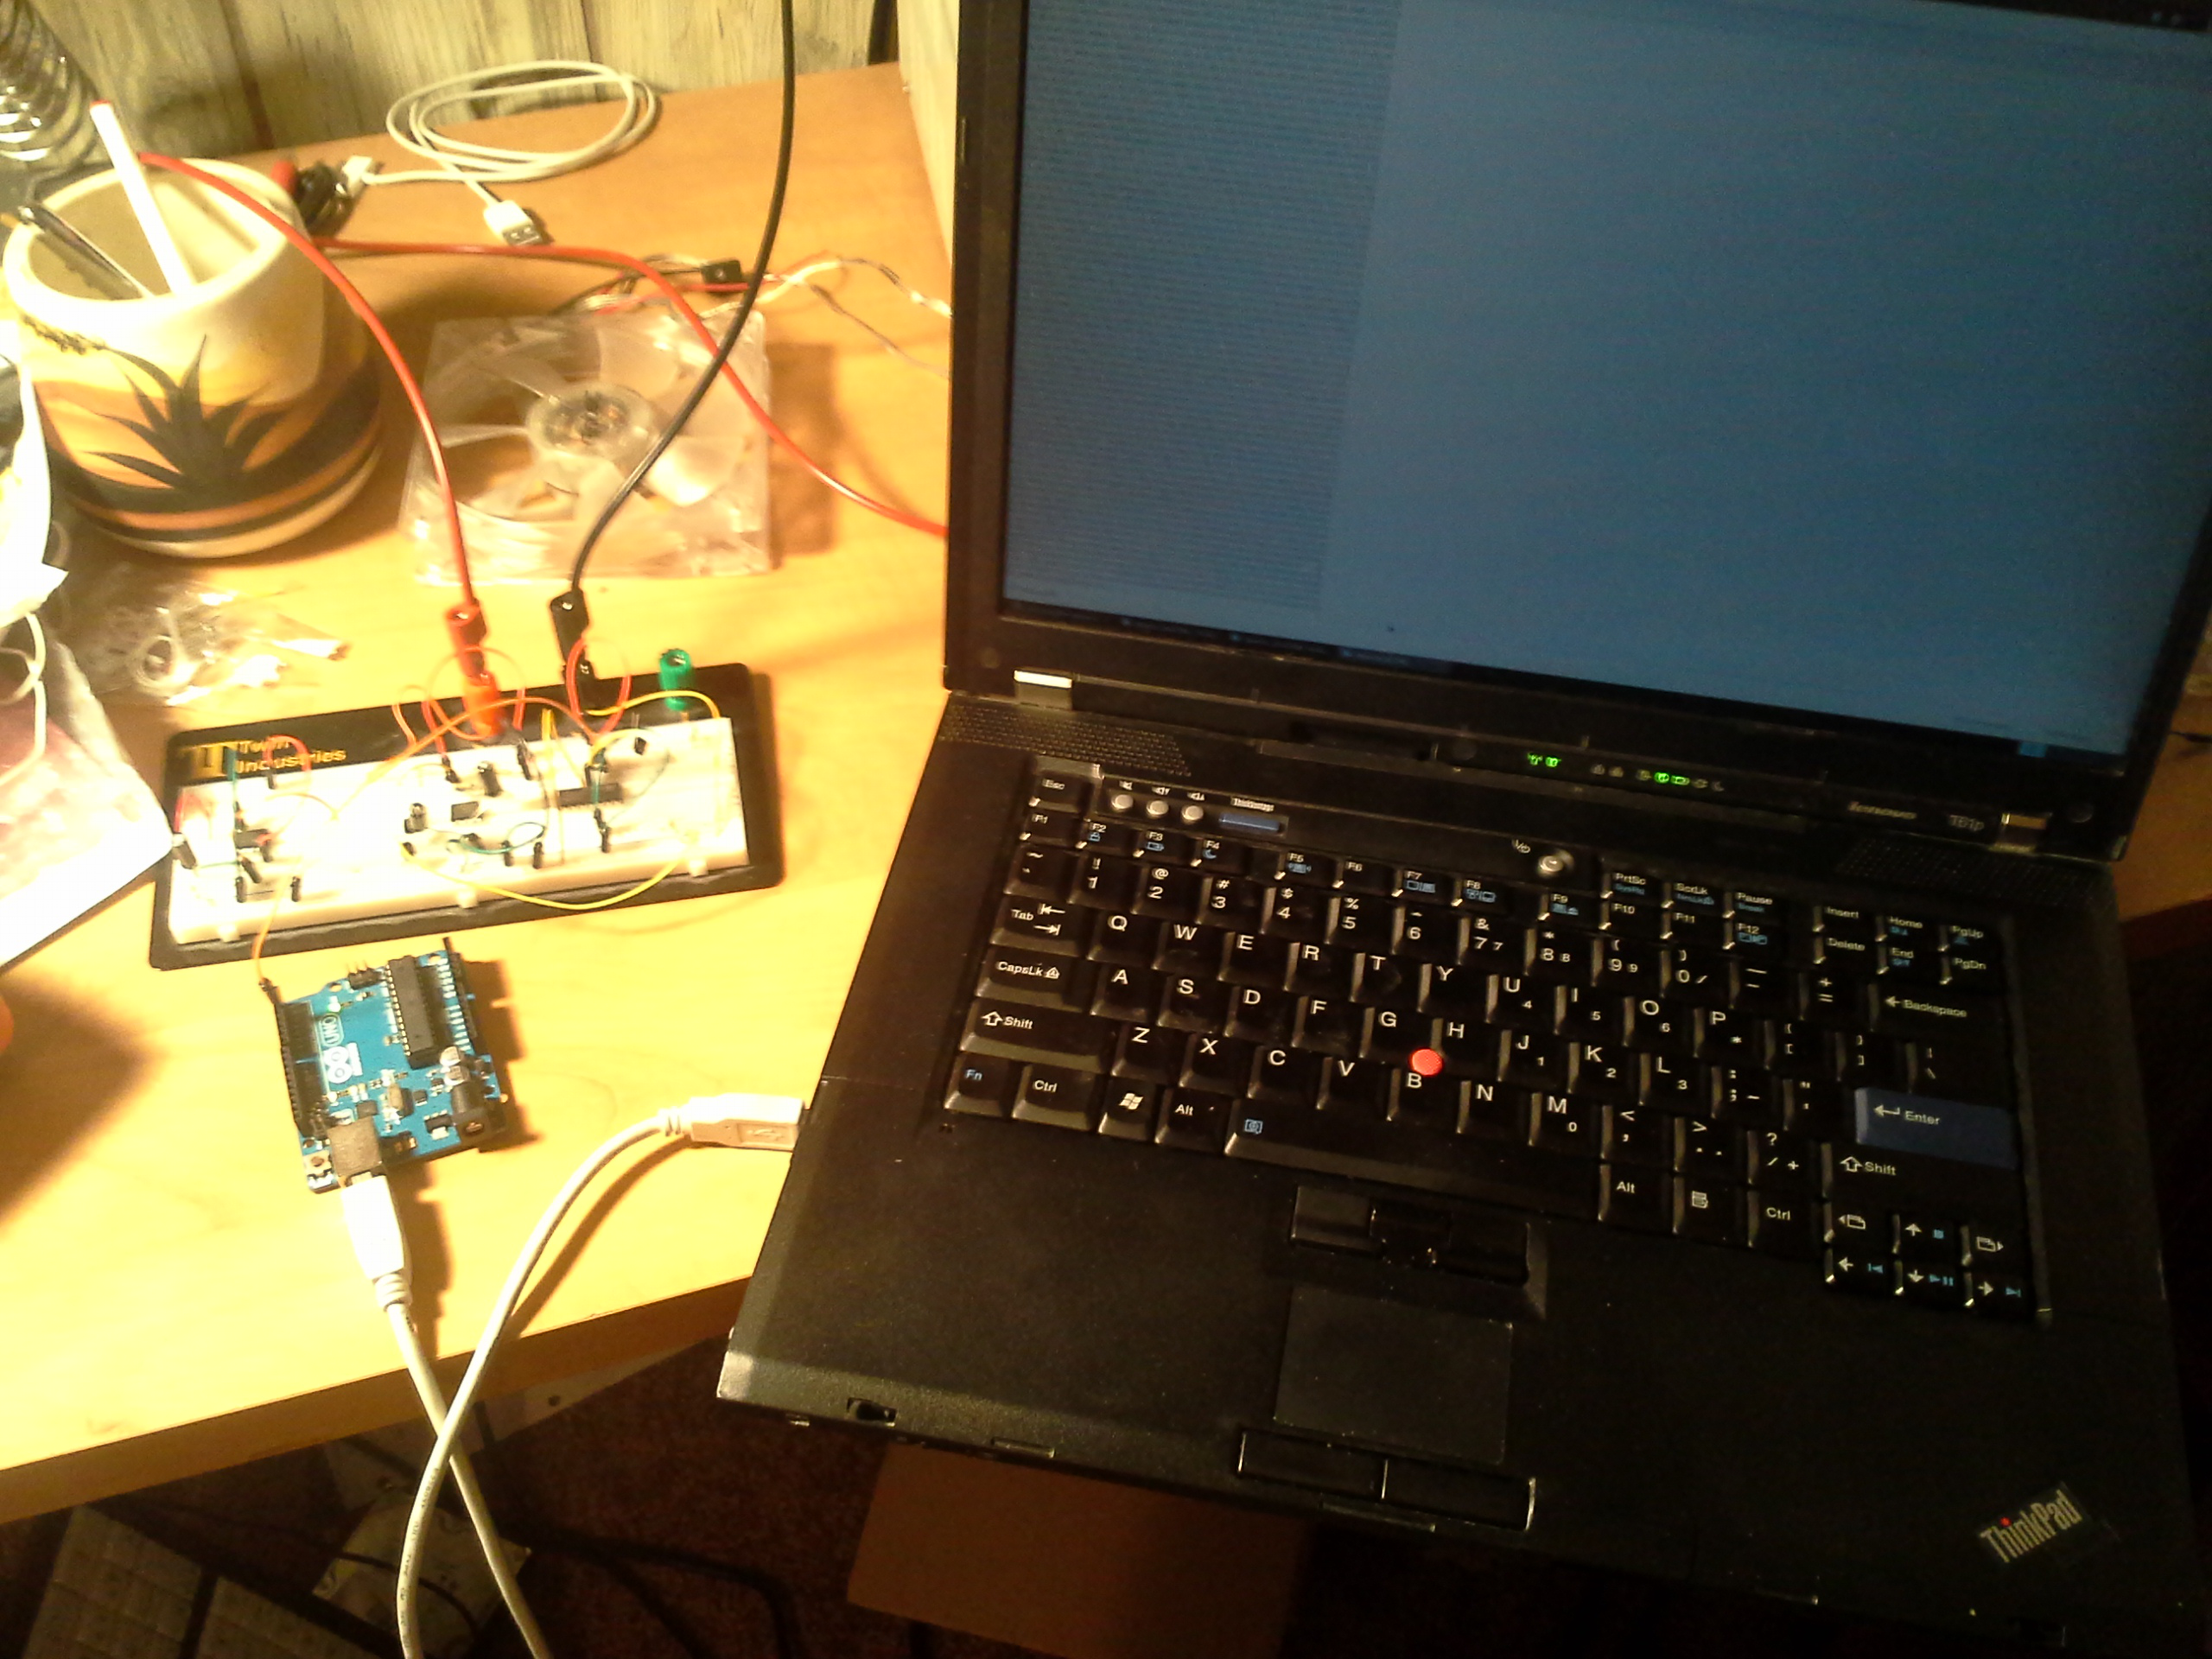
Messy Lab Benches!

Slide 13
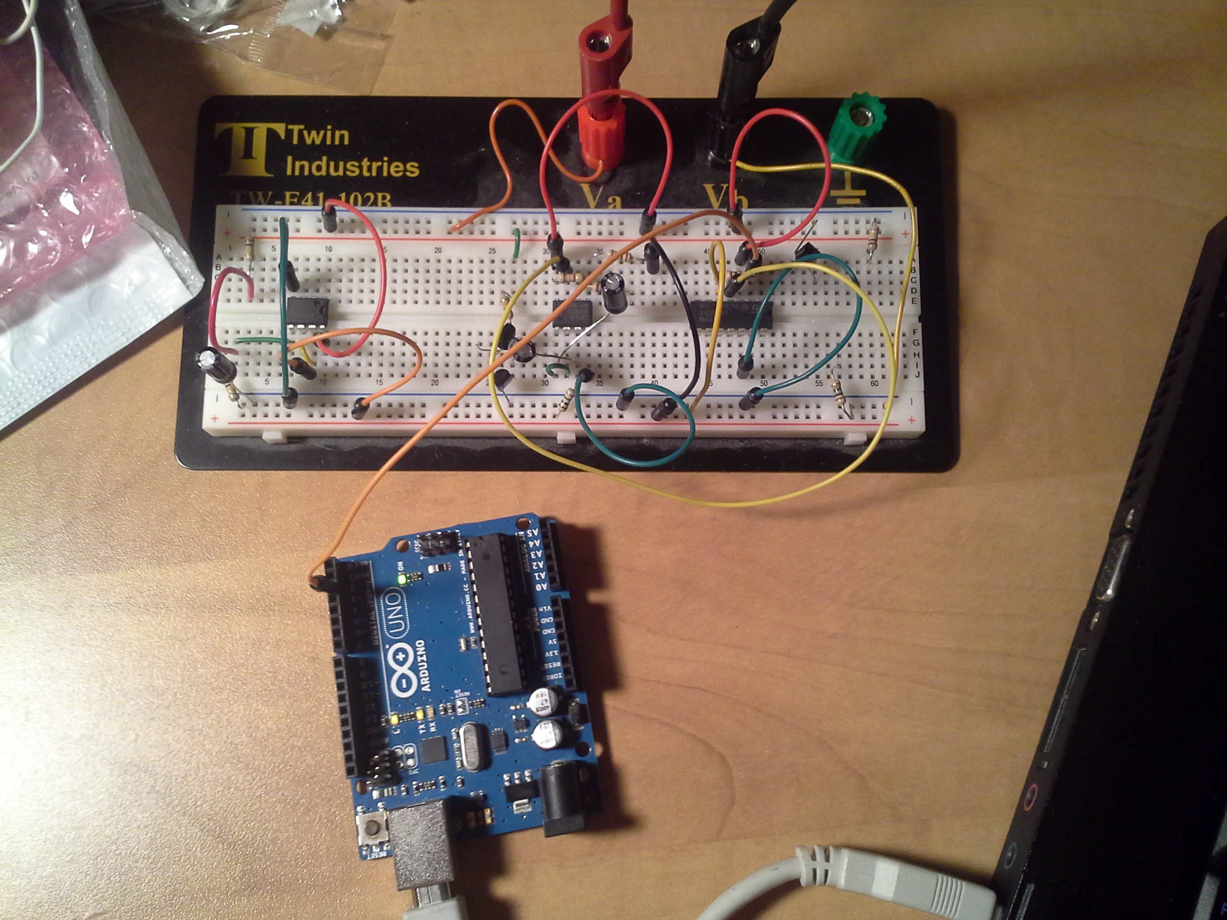
Messy Breadboards!

Slide 14
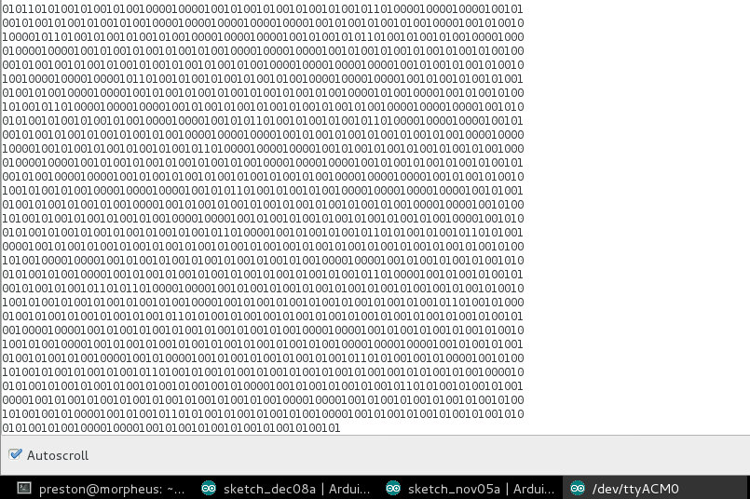
Messy Progress!

Slide 15
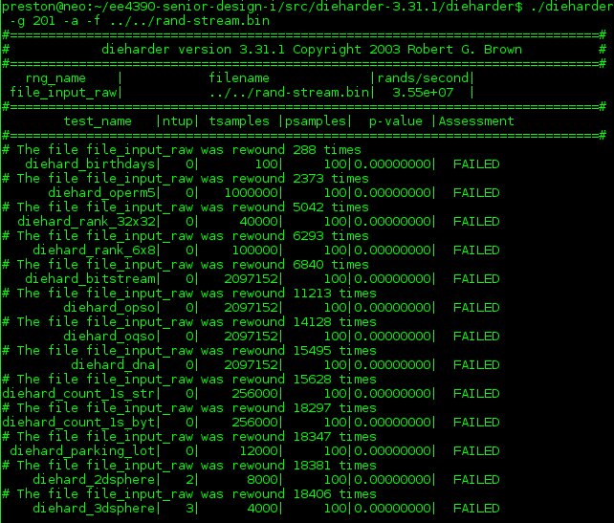

D'OH!

Slide 16

The file was rewound...
OVER 9000 TIMES!

Slide 17

Speed Issues
MY SAMPLING RATE IS BAD
AND I SHOULD FEEL BAD

Slide 18
Looking Forward
Successful verification via faster sampling.
Inclusion into kernel entropy pool.
Automate testing harness.
Verify with hardware.
Parallelized implementation with rapid sampling of each stream to increase throughput.

Slide 19
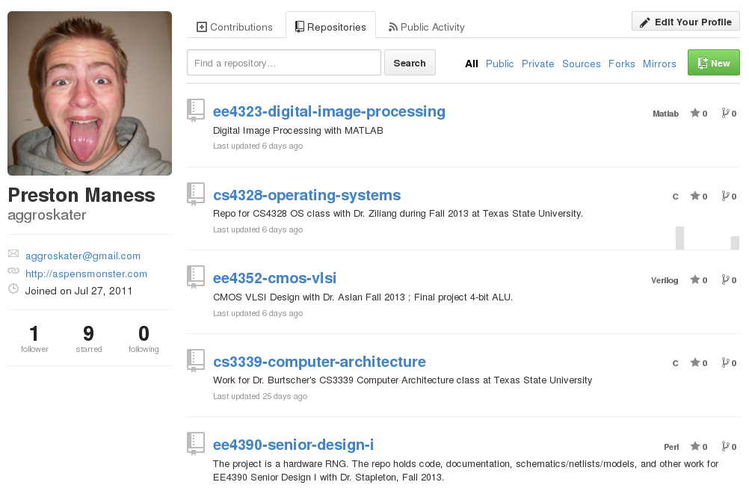
Stalk The Project Manager!
https://github.com/aggroskater?tab=repositories

